Slide 1
HEALTHCARE APPOINTMENT NO-SHOW PREDICTION
RAKSHITHA L

Slide 2
OBJECTIVE
Missed appointments in healthcare can lead to wasted resources, lost revenue, and disrupted patient care.
This project aimed to predict which patients are likely to miss their scheduled medical appointments. By identifying patterns and trends, we developed recommendations to improve scheduling practices and reduce no-show rates.

Slide 3
TOOLS USED
PYTHON :
Used for data cleaning.
POWER BI :
Used for creating interactive dashboard.

Slide 4
DATASET
Source: Kaggle
Records: 110,000+ patient appointment entries.
Key fields: Patient demographics, appointment details, SMS reminders, and no-show outcomes

Slide 5
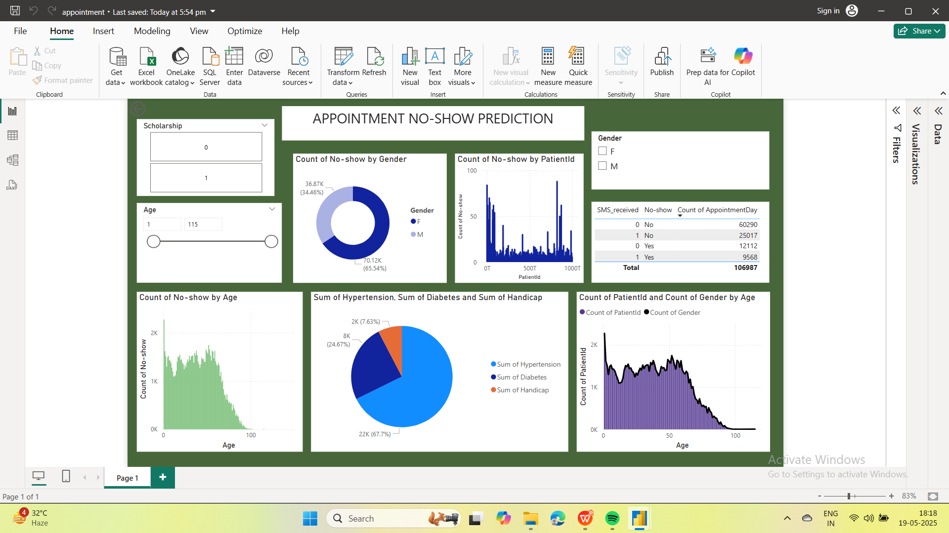
DASHBOARD

Slide 6
RECOMMENDATIONS
Enhancing SMS reminders (e.g., sending multiple reminders closer to the appointment date)
Implementing overbooking strategies on high no-show days (e.g., Mondays, Fridays)
Reducing scheduling gaps for patients with longer wait times.
Targeted outreach for younger patients and high-risk neighborhoods.

Slide 7
THANK YOU

